Slide 1

Disability Finance
OFN Conference
Los Angeles October 23, 2024

Slide 2

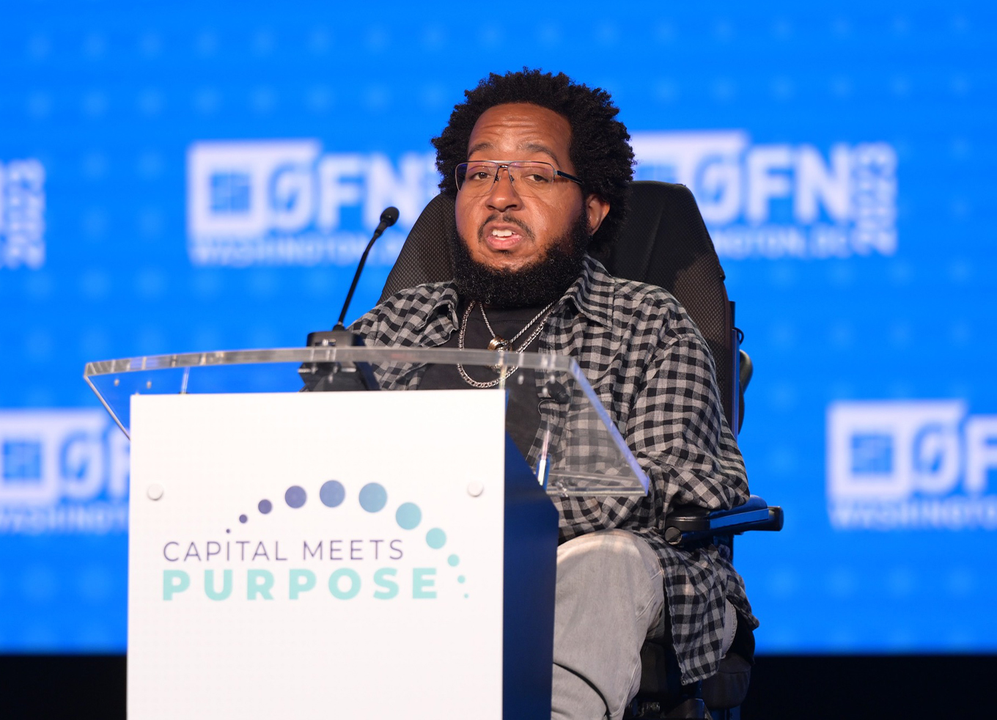
Agenda
Primer on Understanding Disability Identity and
Unmet needs of People with Disabilities
What does this mean for CDFIs?
People with Disabilities as Other Targeted Population
Disability Finance-Financial Assistance
Civil Rights - Title VI Compliance
Disability Finance Stories
How National Disability Finance Coalition can help

Slide 3




Introducing our Panelists
Rita German – Moderator
JPMorgan Chase
Emerson Sekins,
Northwest Access Fund
Will Hall,
Pennsylvania Assistive Technology Foundation
Genny Kurzweil
Disability Opportunity Fund
Pam Porter,
National Disability Finance Coalition

Slide 4

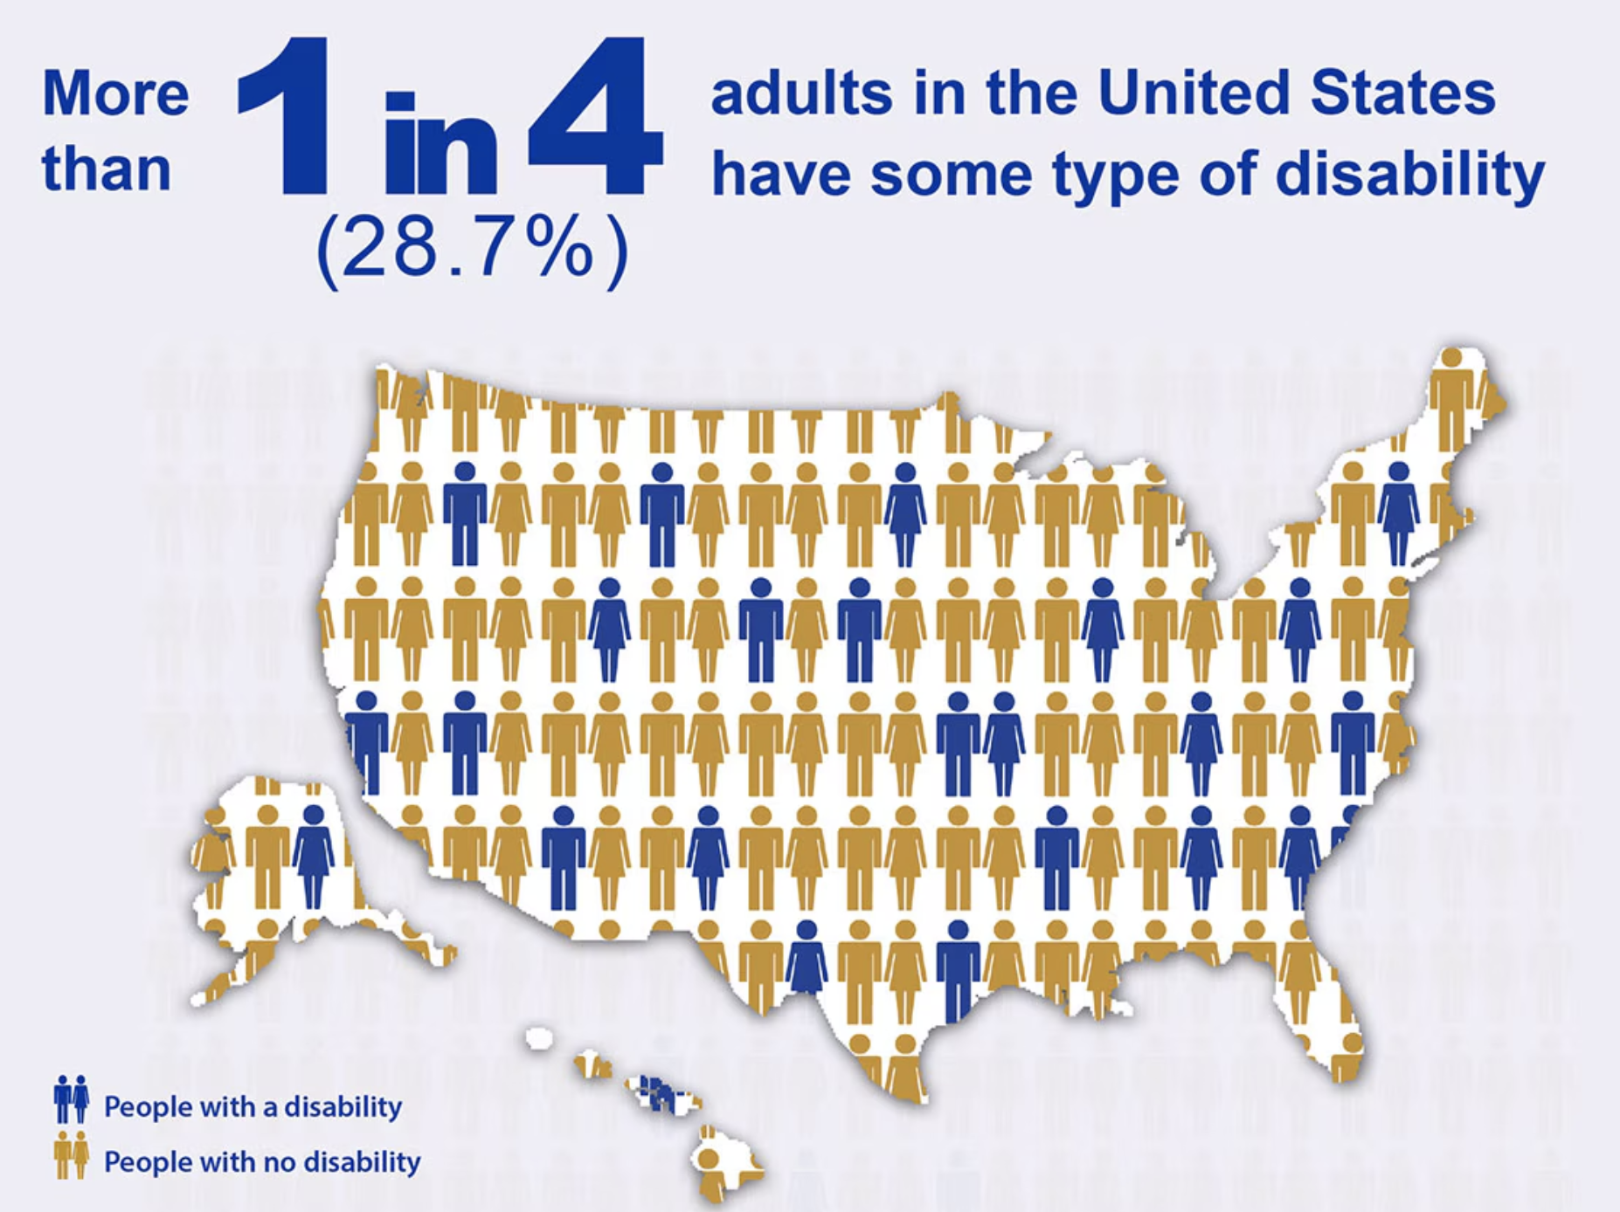

Centers for Disease Control and Prevention. Disability and Health Data System (DHDS)

Slide 5
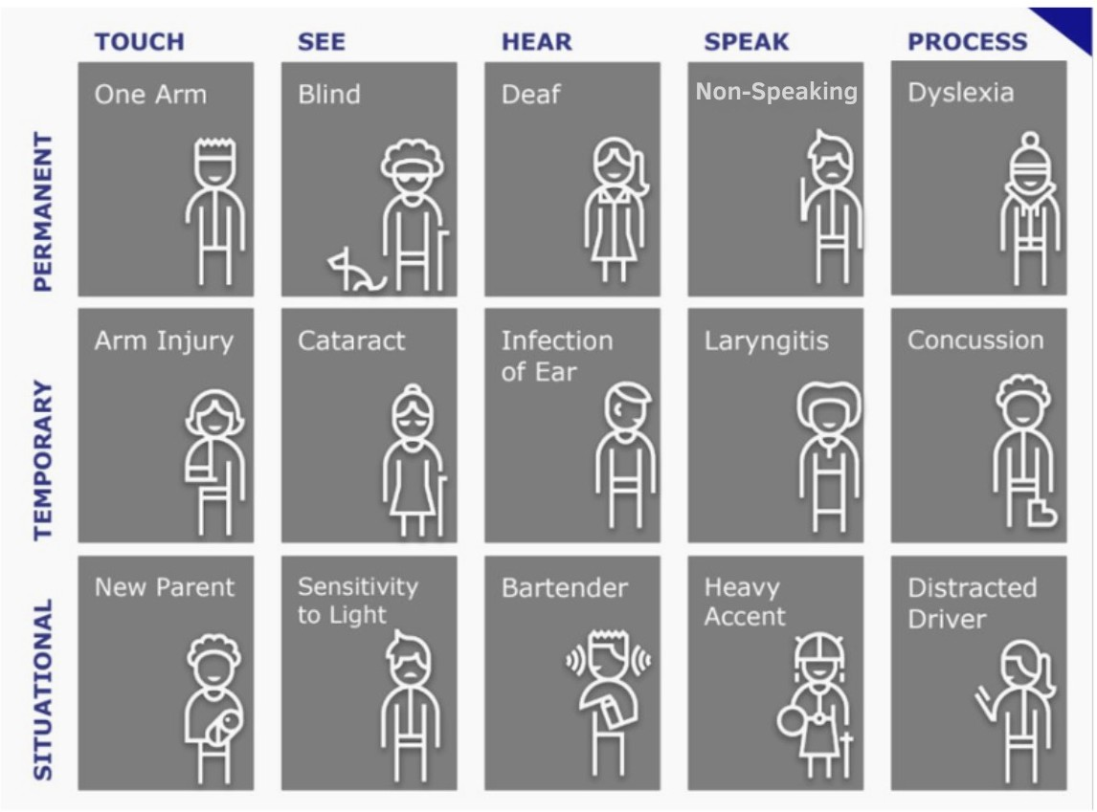

Disability is…
An Identity
A Community &
A Body/Mind Experience
Graphic Source: Tamman (https://tammaninc.com)

Slide 6
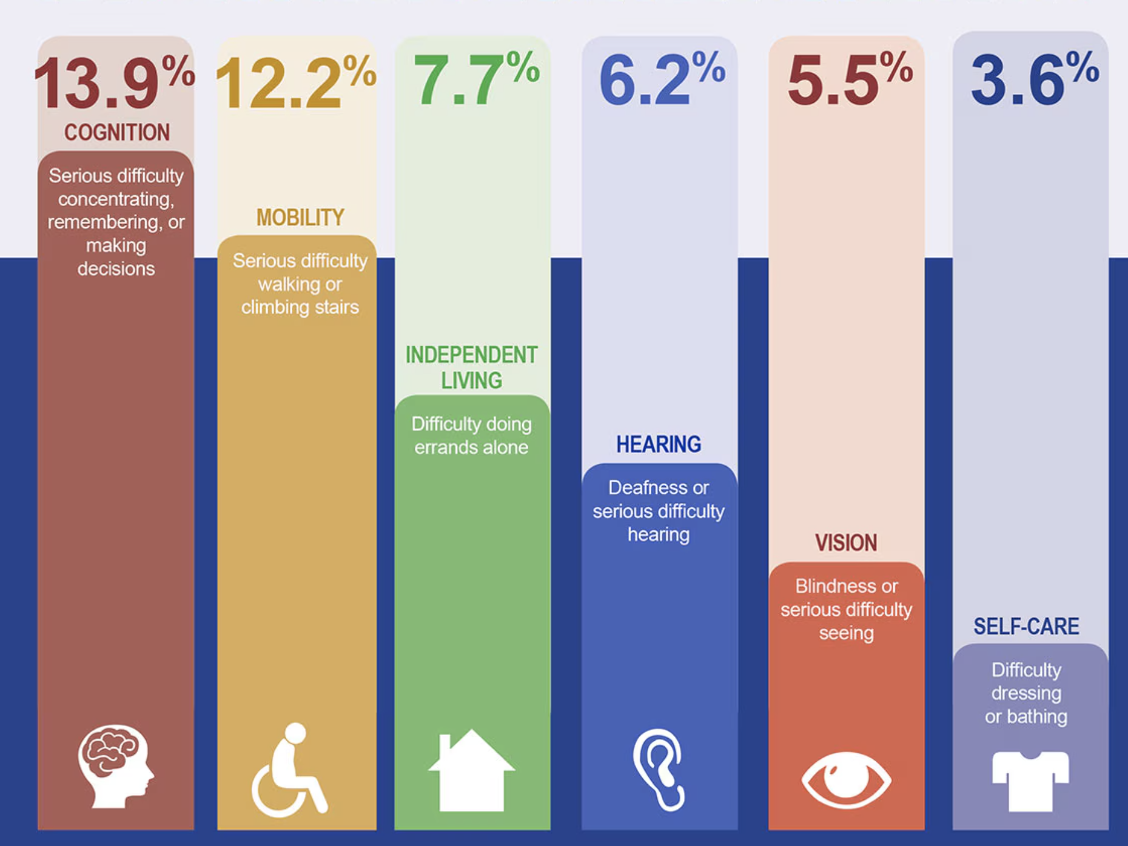
Centers for Disease Control and Prevention. Disability and Health Data System (DHDS)

Slide 7



Models of Disability
Medical
The medical model views disability as a problem of the person, directly caused by disease, trauma, or other health conditions, which therefore requires sustained medical care provided by professionals.
The issue is the individual
Social
The social model of disability proposes that what makes someone disabled is not their medical condition, but the structures or barriers of society:
The issue is the inaccessible world
Physical
Organizational
Attitudinal
Communication
Technology
Affirmational
The affirmational model is “a non-tragic view of disability… which encompasses positive social identities… grounded in the benefits of the lifestyle and life experience of being disabled.
Oliver (2013), Thomas (2004) Swain and French (2000)
I am a disabled person in whatever world exists

Slide 8
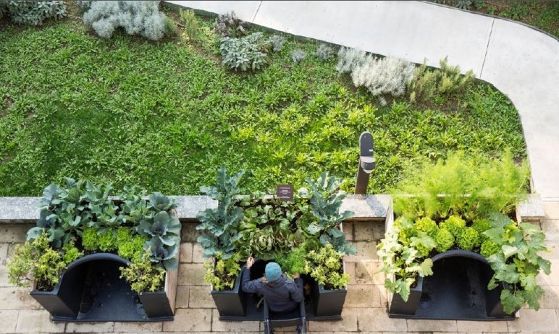
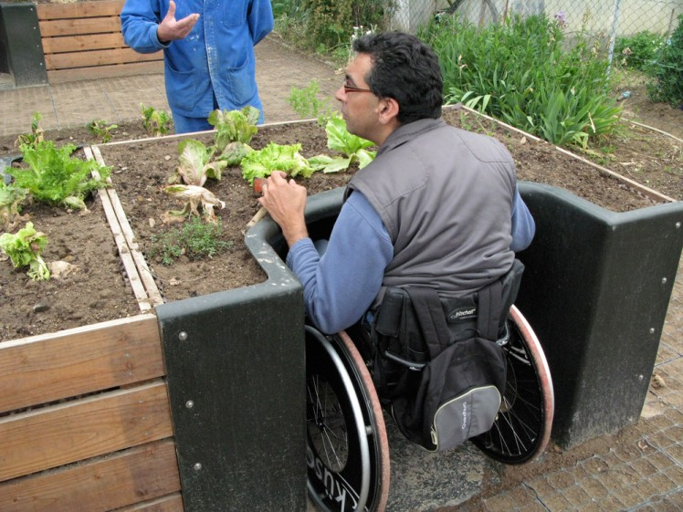
Re-Framing Disability
Medical Model
Can you tell me what is wrong with you?
What are your problems with accessing this event, building, or program?
Based on your limitations, you would be better off doing this.
Social Model
Can you tell me what is wrong with the environment (or the virtual experience?)
How can we best accommodate you? (adapt)
How can we create experiences that are more inclusive? (design)
Does this garden affirm a positive experience? (Affirmational Model)
Terraform- Accessible Garden Beds

Slide 9

Reference: United Spinal Association

Slide 10
If You Learn One Thing…
STOP SAYING “HANDICAP”
SAY
“ACCESSIBLE”

Slide 11
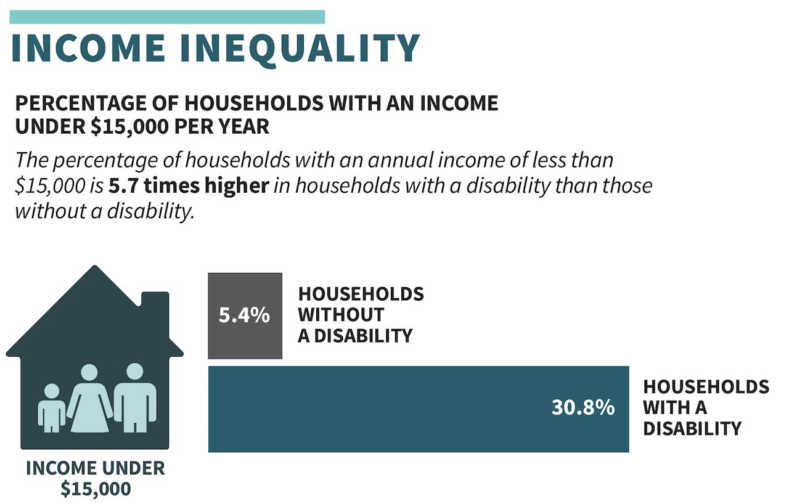
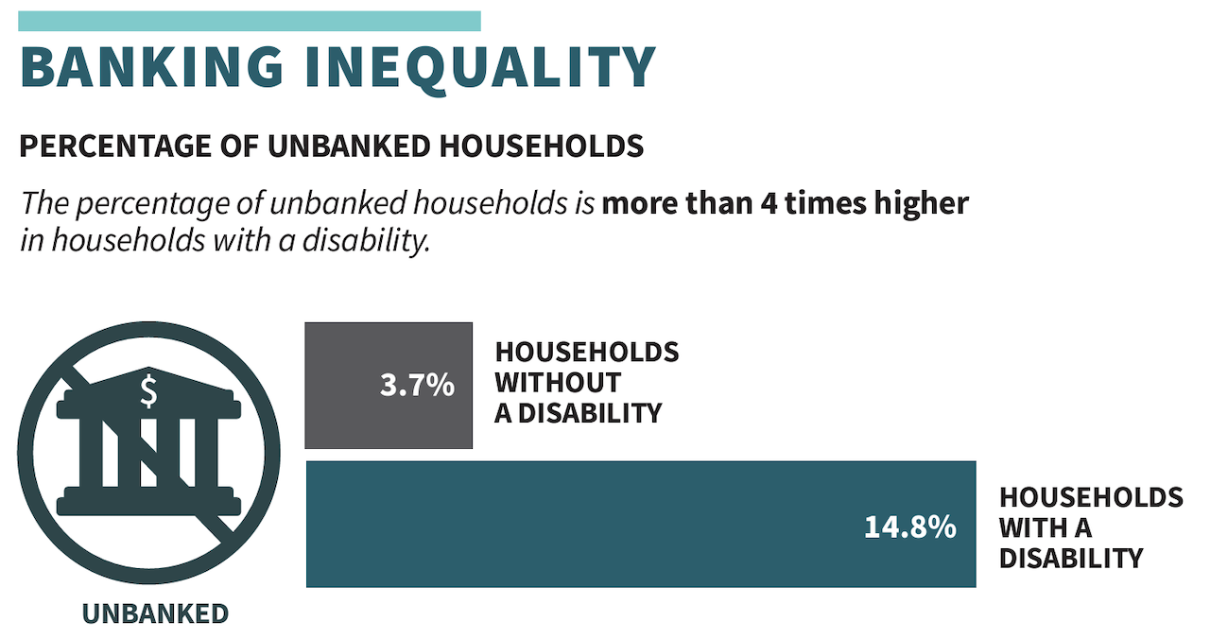
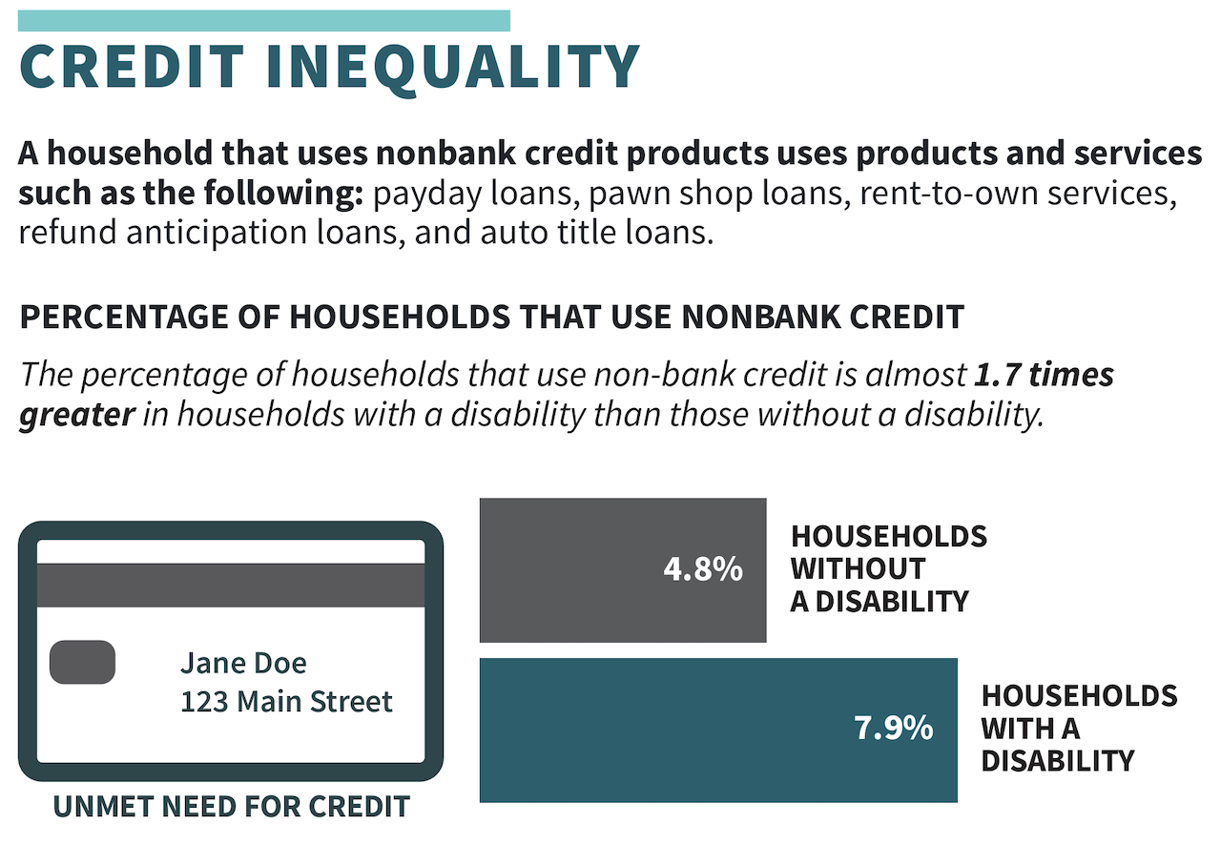

National Disability Institute’s (NDI) analysis of data from the 2021 FDIC Survey of Household Use of Banking and Financial Services

Slide 12
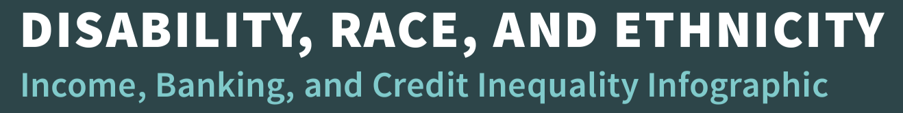
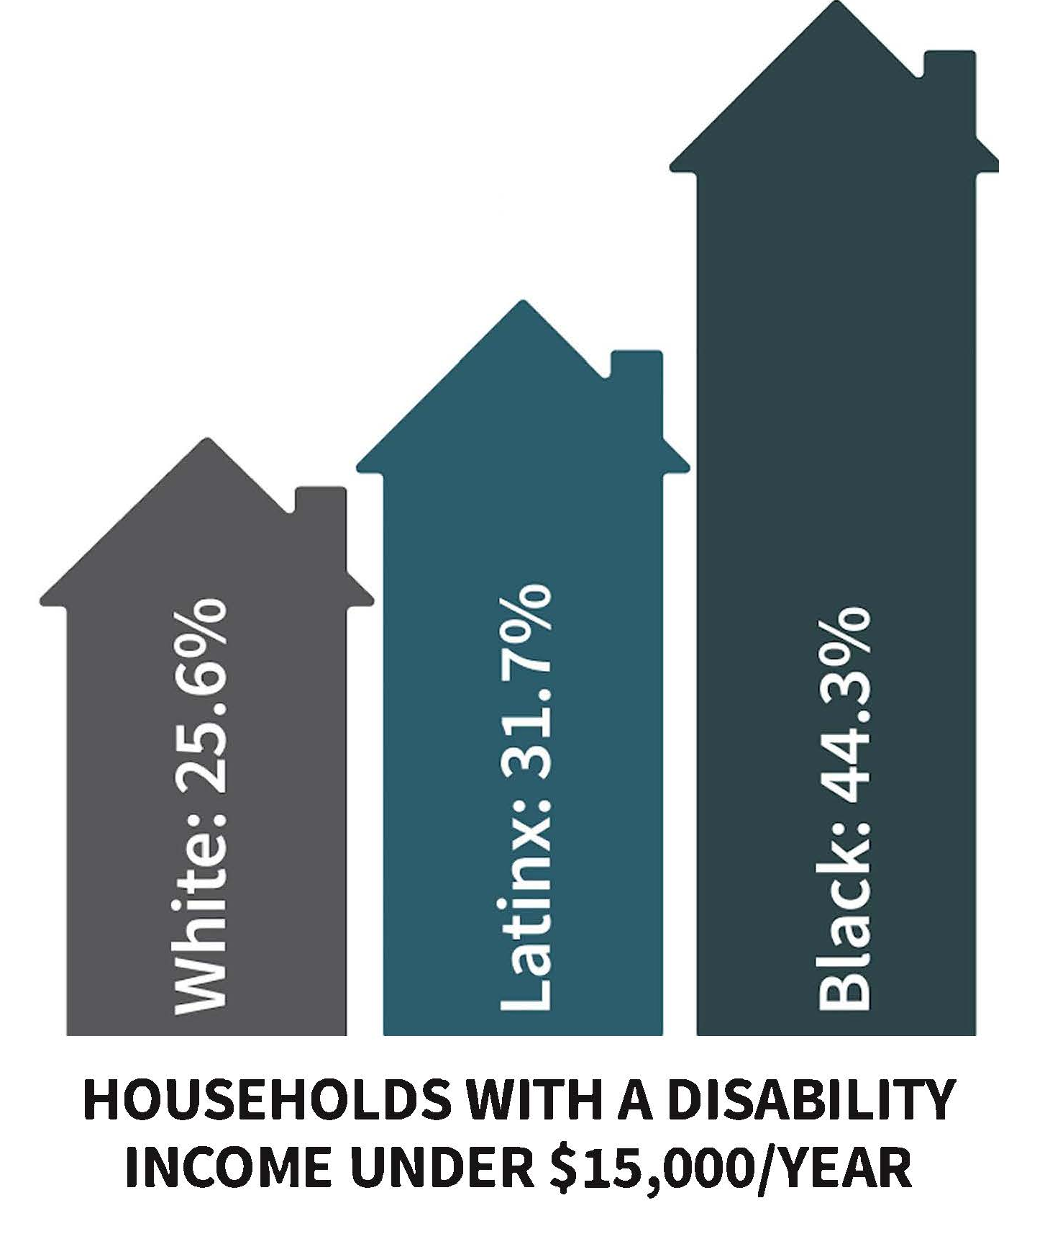
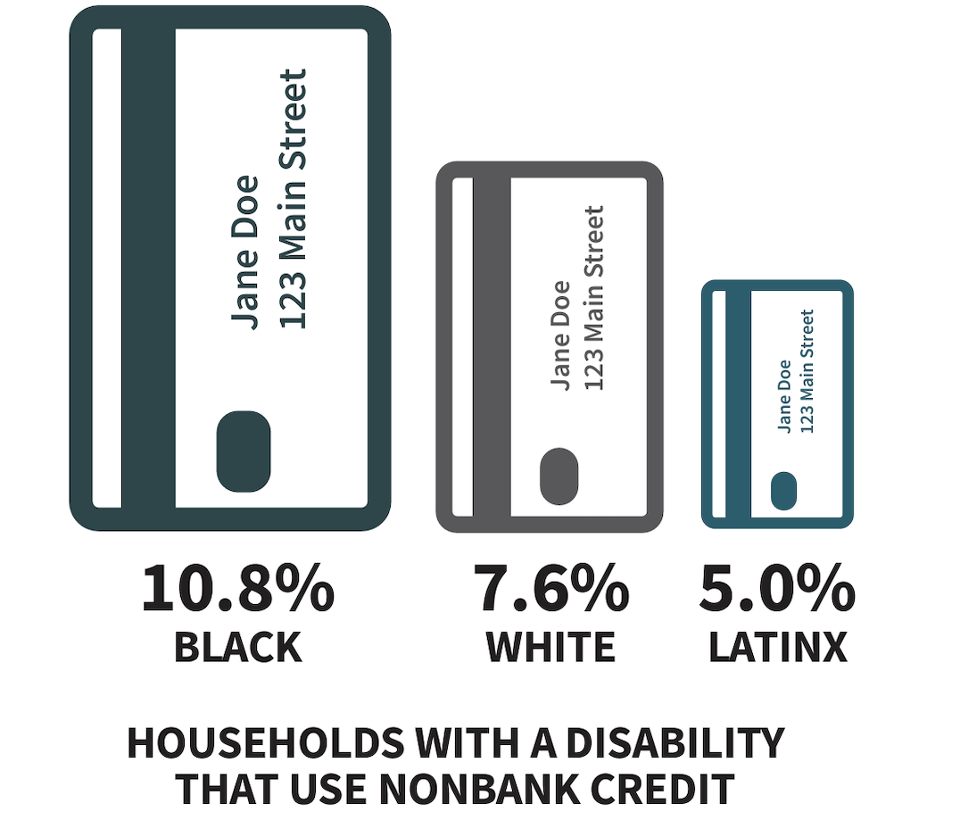
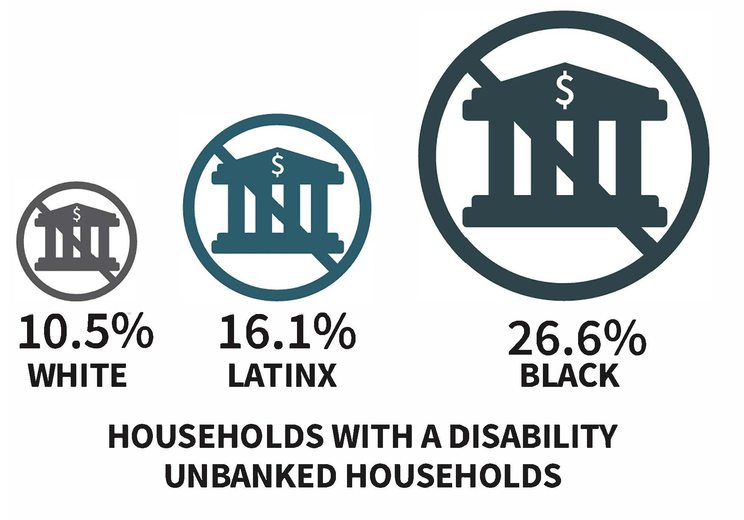
National Disability Institute’s (NDI) analysis of data from the 2021 FDIC Survey of Household Use of Banking and Financial Services

Slide 13

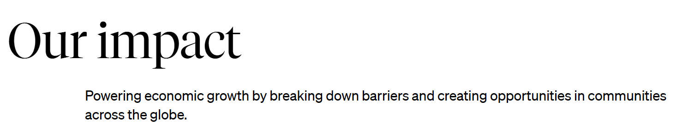
Philanthropy’s focus on Accessibility

Slide 14

CDFI Fund & Disability Finance
People with Disabilities as Other Targeted Population (NEW!)
PWD OTP Eligibility
CDFI Fund definition of disability
PWD Assessment Methodologies
PWD Target Market Accountability
Disability Fund Financial Assistance (DF-FA) ($$!!)
Expected FY25 DF-FA Summary
DF-FA Application
Civil Rights – Title VI Compliance

Slide 15

People with Disabilities (PWD) as Other Targeted Population (OTP)!
The CDFI Fund added people with disabilities as an OTP! This change was made given the abundance of evidence of the economic challenges and barriers of people with disabilities, and advocacy efforts of CDFIs and NDFC
What does this mean?
Broadly speaking, loans benefiting people with disabilities can be reported to the CDFI Fund and will count towards CDFI award lending targets, including:
Loans to people with disabilities
Loans to legal guardians/caregivers
Loans to businesses owned by people with disabilities
Loans to businesses or non-profits primarily serving people with disabilities
Loans to entities with sole purpose of producing Assistive Technology or disability-related accessibility modifications

Slide 16
PWD OTP Eligibility
Individuals:
At least 50% of the individuals named are assessed as a PWD; or
At least 50% of the individuals named are the legal guardian or caretaker of a PWD and at least 50% of the end beneficiaries are PWD
For-Profit Entity:
At least 50% of the owners are assessed as a PWD; or
At least 50% of the end-user recipients are PWD
Nonprofit Entity:
At least 50% of the end user recipients of the Financial Product are assessed as a PWD
For-Profit or Nonprofit Entity:
Entities whose sole purpose is to produce/deliver disability-related assistive technology or accessibility modifications.

Slide 17
CDFI Fund: Defining Disability for OTP
The CDFI Fund uses the Americans with Disabilities Act (ADA) to define disability.
A person has a disability if they have a:
Physical or mental impairment that substantially limits major life activities,
History or record of such an impairment, or
Perceived by others as having such an impairment

Slide 18
PWD OTP Assessment Methodologies
Self Report – Individual, owner, or end user self-reports as a PWD
Visual/Auditory/Documentation –Financing or recipient entity assesses an individual’s/owner’s/end user’s status as a person with a disability visually or auditorily (in person, by video, or telephonically) or via the collection of acceptable documentation
Technology/Accessibility – Sole purpose of the Financial Product is for the purchase/production/delivery of disability-related assistive technology or disability related accessibility modifications.
Legal Guardianship/Caretaker Documentation – Financing entity collects acceptable documentation in combination with an assessment of the end user(s)’s status as a person with a disability via a pre-approved assessment methodology.

Slide 19
PWD Target Market Accountability
Governing Board:
At least one governing board member needs to be accountable to PWD Market to add PWD as a Target Market; and
At least 33% of the governing board is accountable to the overall proposed Target Market(s).
Sources of Accountability
Status as a member of the Targeted Population (Person with a Disability)
Status as an executive staff member of a non-affiliated, community development mission-driven organization that primarily provides services to PWD (Unique to OTP-PWD)
Family member of a person with disabilities (OTP – PWD only)
Spouse, Parent, Child, Sibling, Aunt or Uncle, Grandparent, Stepparent, Stepchild, Step-sibling, In-law parent, or In-law sibling

Slide 20
Expected FY 25 DF-FA Summary
Eligibility | Applicant Must Receive Base-Financial Assistance (FA) Award to receive a DF-FA Award
Award Amount | Maximum Award: $500,000 TOTAL AWARDS: $10,000,000 Minimum Award: $100,000 EST. TOTAL # of AWARDS: 15 Estimated Avg: $500,000
Activities | DF-FA awards may be expended for activities in four categories: Financial Products Financial Services Development Services Loan Loss Reserves
Lines of Business | DF-FA awards may be expended for: Community Facilities Small Business Housing | Consumer Commercial Intermediary Other
Other | Match requirements mirror FA | DF-FA does not count toward $5million max

Slide 21
DF-FA application has four questions
Describe the needs and challenges of individuals with disabilities within the communities you serve
Discuss your strategy for meeting the needs and challenges
How will you increase/expand products and services
Partnerships to further your support of individuals with disabilities

Slide 22
Civil Rights – Title VI Compliance
From the CDFI Fund: “organizations are prohibited from discriminating against program participants because of their race, color, national origin, disability, and age”
Website Example: Federal Compliance | The Disability Opportunity Fund (thedof.org)
Commitment to nondiscrimination
Accessibility to PWD and reasonable accommodations
Provision of language services
Contact information for filing complains

Slide 23

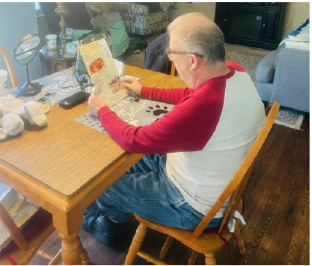
Scott’s Story
Scott is a PATF borrower who wanted to purchase a pair of AI-powered smart glasses to pair with his Envision smart phone app
PATF was able to provide a loan in time for Scott to be able to purchase the glasses at a discount
PATF was able to work fast, with no fees, and at no interest
Scott has since received a grant to help him pay down his loan faster

Slide 24

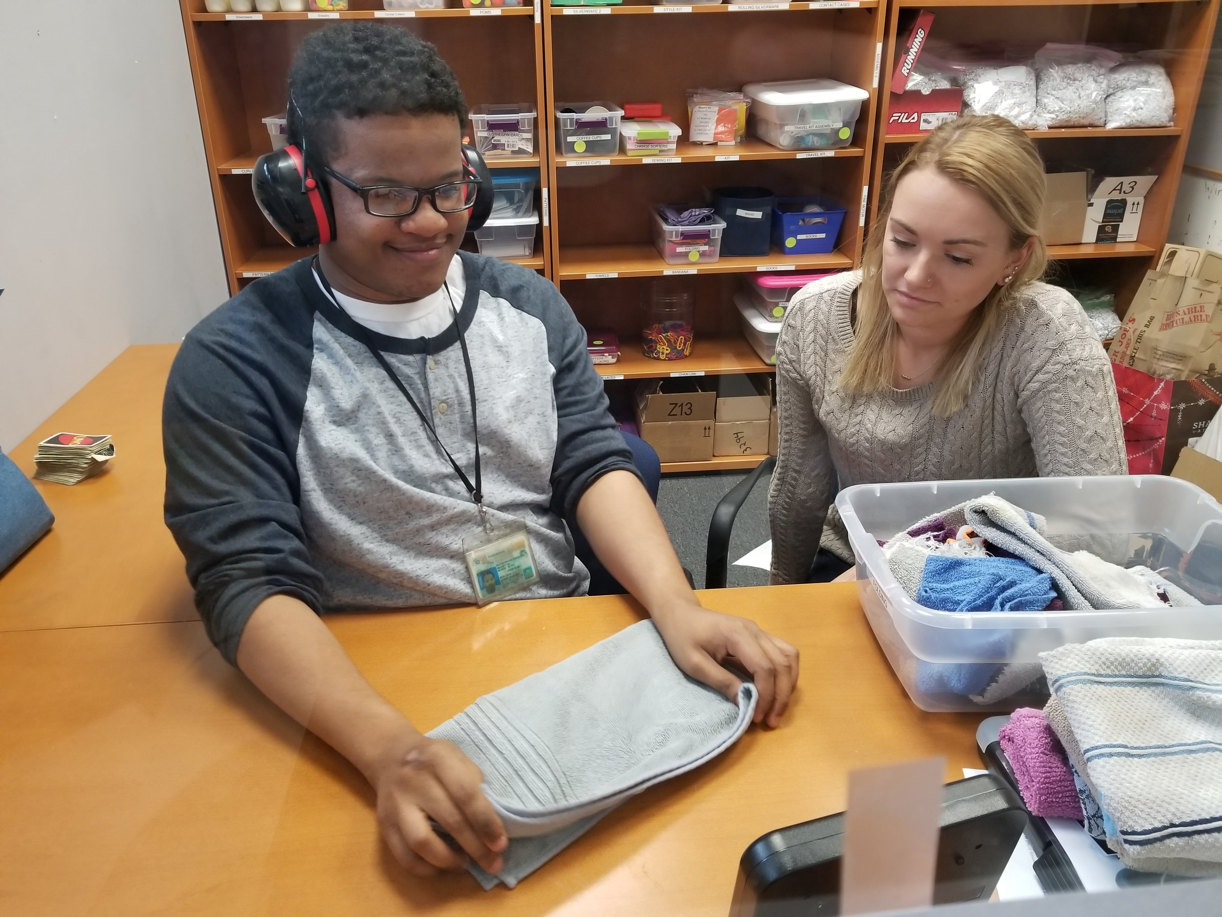
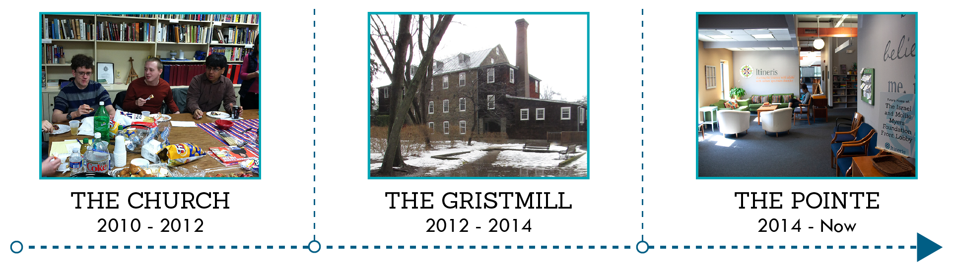
Itineris Baltimore, MD Loan Amount: $2,600,000
The organization focuses on evidence-based programs that support autistic adults so they can live their most meaningful life. Adults participate in work awareness and job readiness classes, social skills, community integration, decision-making and self-advocacy, technology, independent daily living skills, functional academics and fitness and wellness classes.
Problem: Owner was selling the building Itineris occupied. Itineris wanted to buy the building but didn’t have the money. Weinberg Foundation told Itineris they will give them a grant once they buy the building but Itineris needed the grant to buy the building.
Solution: DOF!

Slide 25
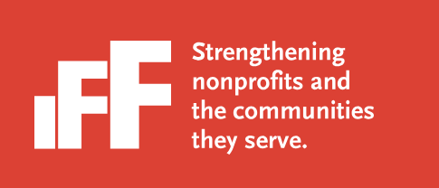

Inclusive Spaces in Early Childhood Education Centers
Inclusive Spaces, a micro-grant program to fund accessibility and sensory-friendly improvements in ECE facilities
Earmarks loan origination fees from CDFI Fund DF-FA awards into micro-grants to benefit ECEs
$50,000 awarded to date to centers in Detroit and Grand Rapids in MI and Chicago and East St. Louis in IL.
“Not just kids in wheelchairs….the mom with a double stroller; the grandmother who uses a walker”
“Make ECE spaces more welcoming to neurodivergent clients …. Think of replacing those buzzing fluorescent lights.”

Slide 26

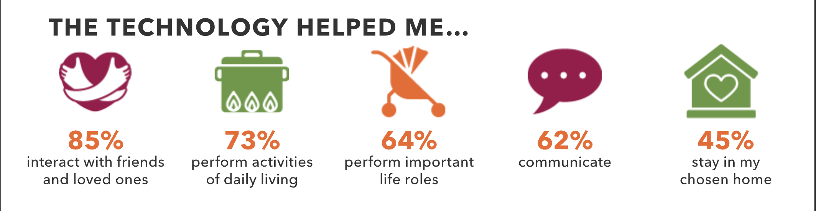
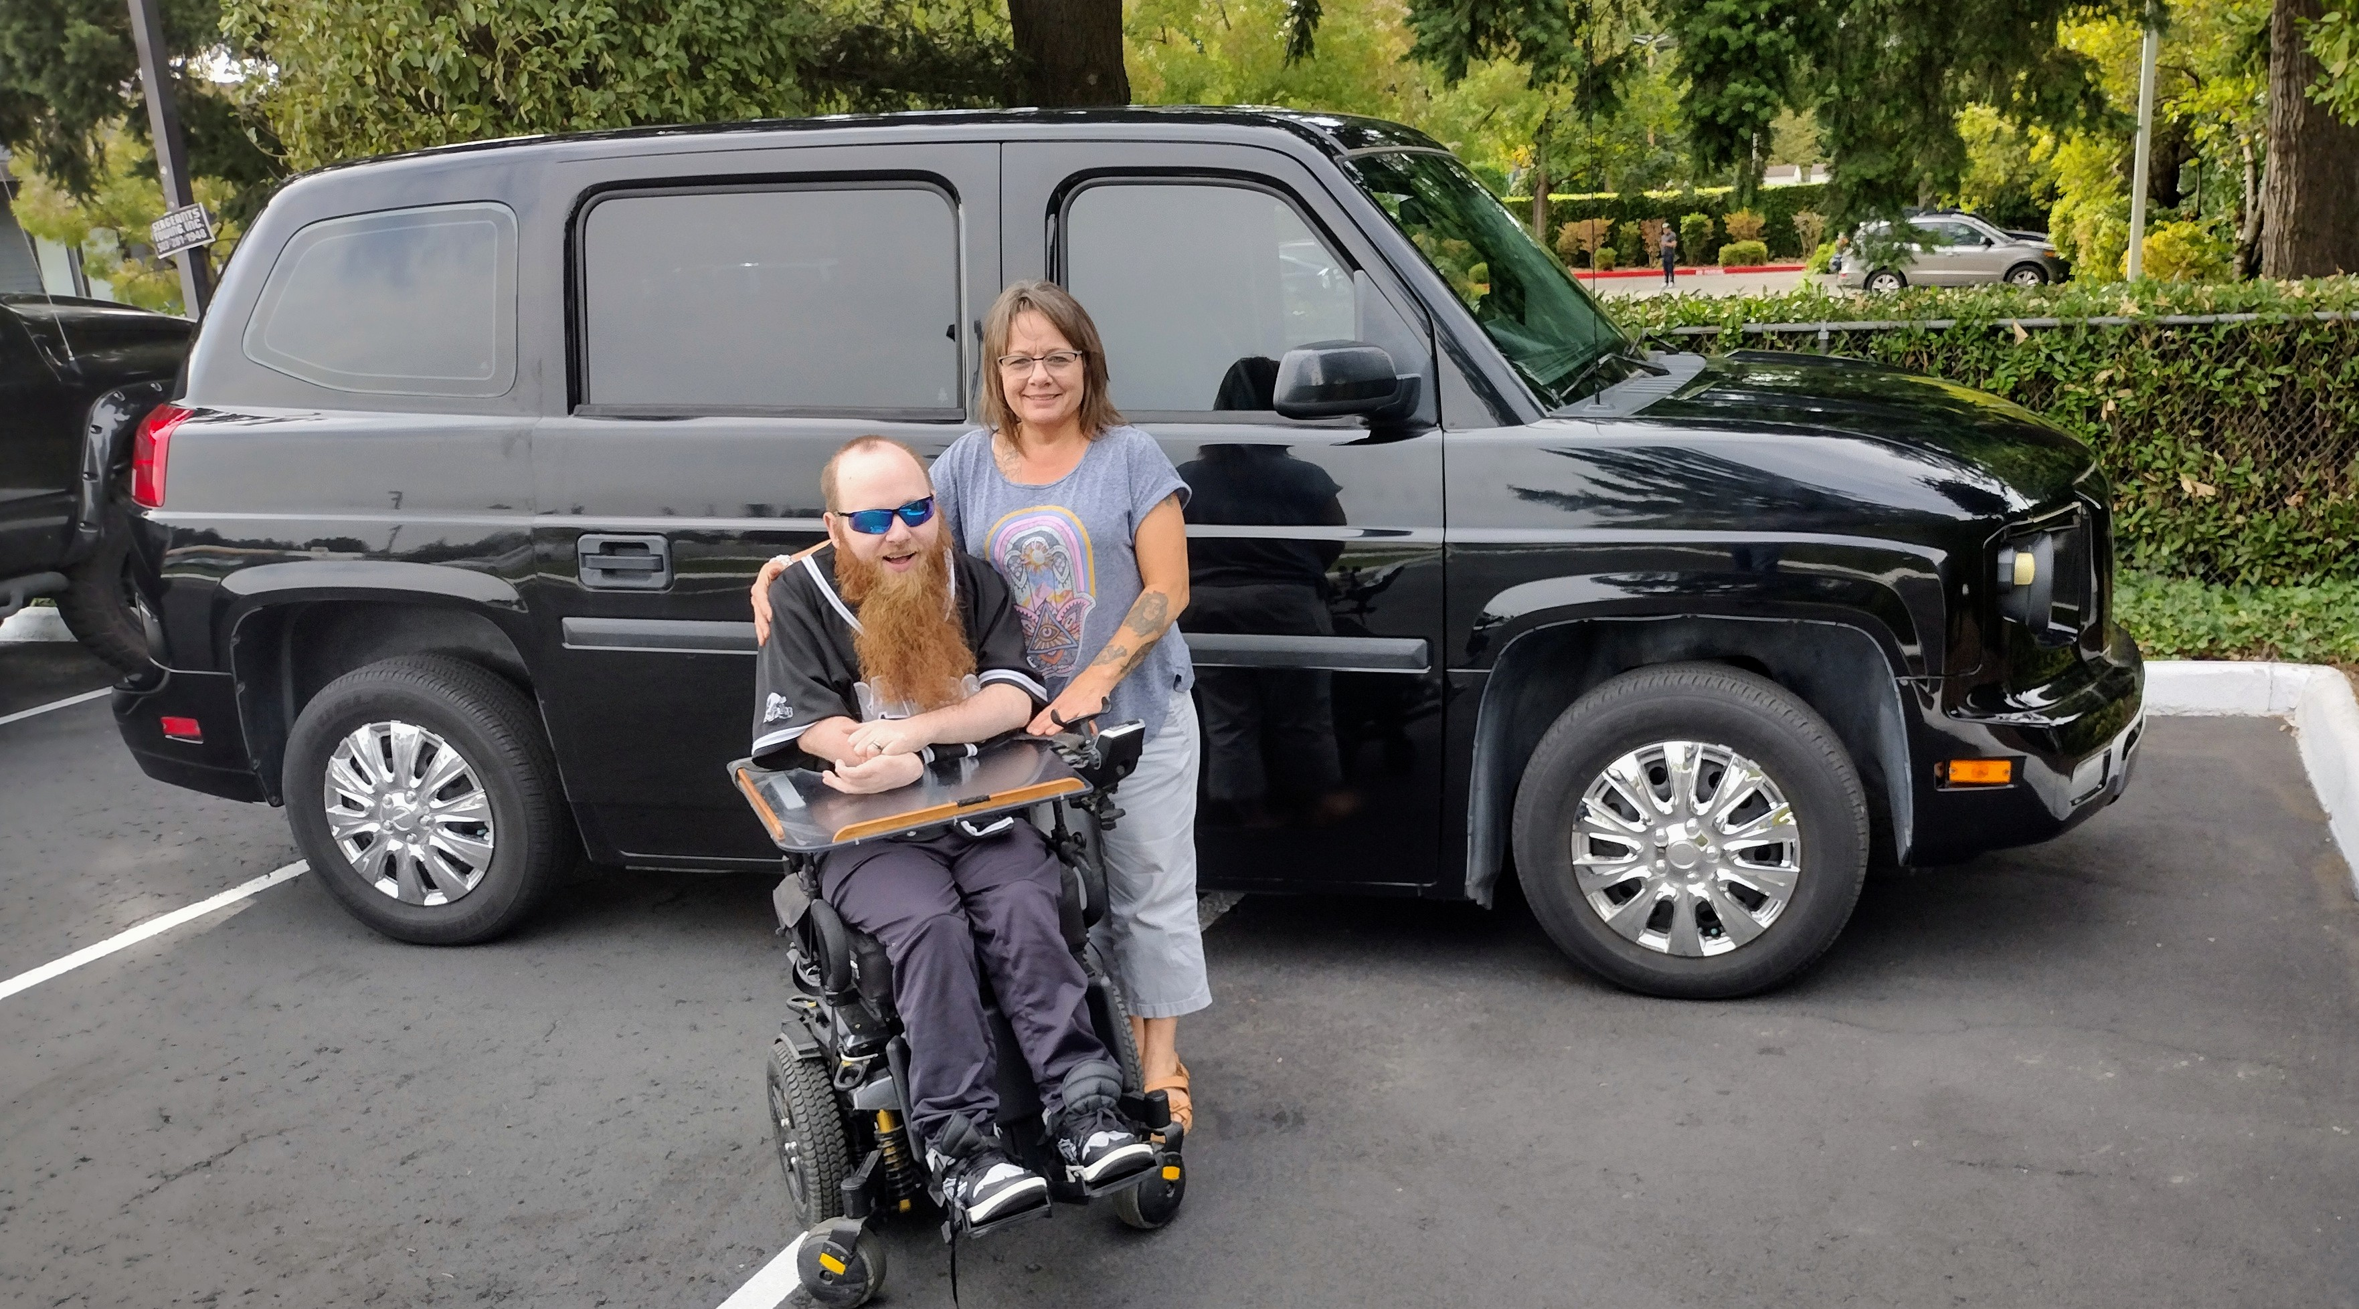
Impact of Disability Finance
[In our new van] “Josh is so much more comfortable because he is facing the right way and has shoulder seat belt which helps him sit better. Sitting better makes his breath control easier so he isn't so exhausted after a conversation, and he is easier to understand. I have to stop I get tears.... THANK YOU!"
Case Study
Loan Details
Purpose: Refinance high-interest debt the client took on to afford bathroom and car repairs; she was paying $662/month on outstanding debt
Amount: $4,650
Term: 30 months
Mo. Payment: $165.21
Borrower Profile
Credit Score: 584
Monthly Income: $1,102
Income Sources: Social Security Disability Insurance(SSDI) & tribal reimbursements for Medicare, cell phone and groceries

Slide 27
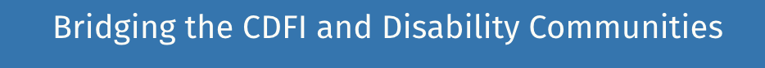
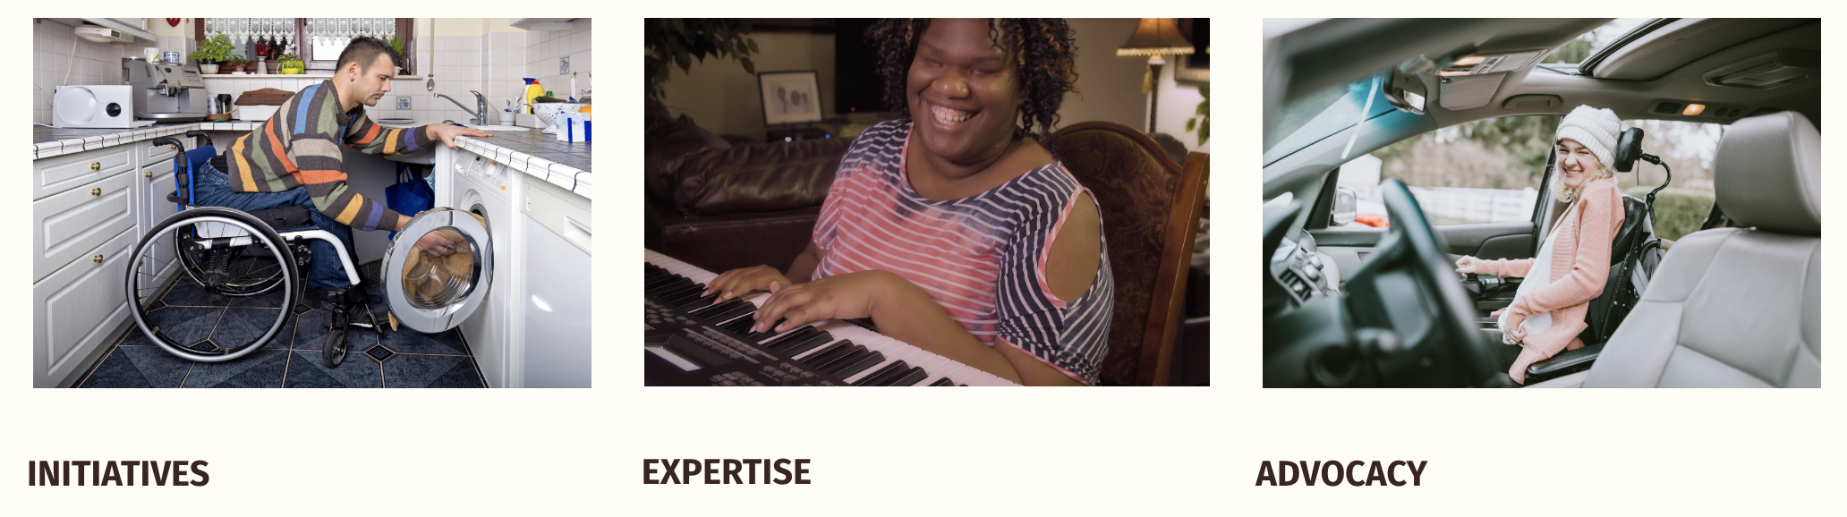
disability-finance.org

Slide 28
NDFC Programs
Peer learning
Disability Finance training
Advocacy
Affinity Groups:
Community Development Professionals with Disabilities
Accessible, Affordable Housing
Connect with NDFC!
Pam Porter, Executive Director
pam@steppingstonepartners.com
Emerson Sekins, Board Chair
emerson@nwaccessfund.org
disability-finance.org
QR CODE

Slide 29
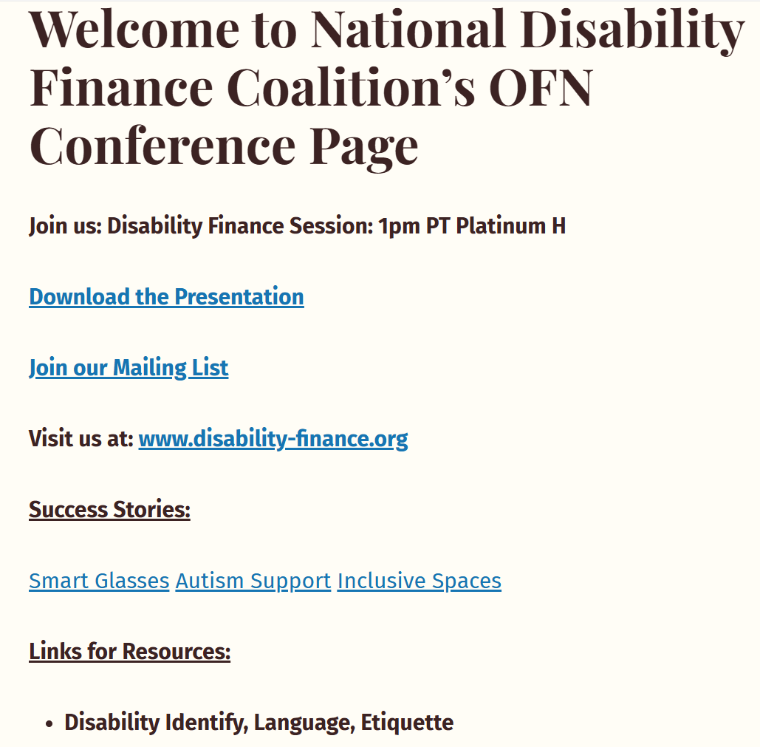

Slide 30
